Slide 1
ASP.Net Core –Rendering HTML using Razor views
Kamal Beydoun
Lebanese University – Faculty of Sciences I
Kamal.beydoun@ul.edu.lb

Slide 2
Introduction: UI
For desktop apps, that might be WinForms or Windows Presentation Foundation (WPF).
For Web APIs, that might be a nonvisual view, such as a JSON or XML response.
For traditional web applications, the UI is the HTML, CSS, and JavaScript that’s delivered to the user’s browser directly, and that they interact with.
In ASP.NET Core, views are normally created using the Razor which uses a mixture of HTML and C# to generate the final result.
Razor can use C# as a control mechanism, so adding conditional elements and loops is simple, something you couldn’t achieve with HTML alone.
ASP.NET Core and the Razor include a number of helpers that make generating HTML forms easy, called Tag Helpers.

Slide 3
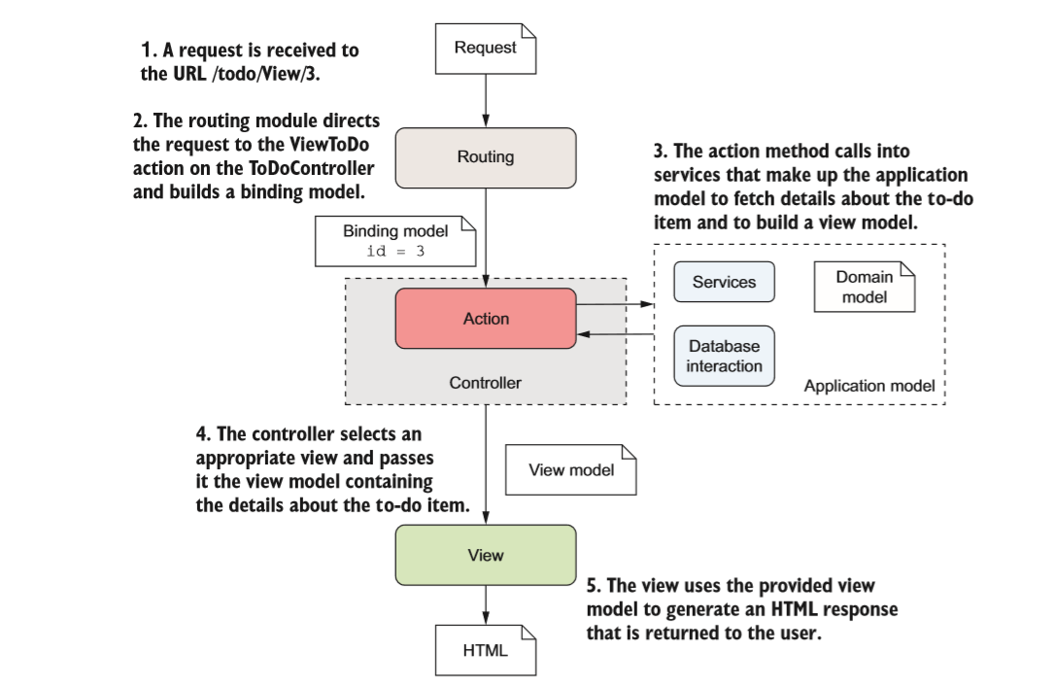
View Model
As part of this process, either the application model or the controller itself generates a view model.
The view model is a custom class that contains all the data required to render a view.
The final task for the action method is to choose a view template to render.
Notes:
In most cases, an action method will only need to render a single type of template, but there are situations when you might like to render a different one depending on the data you get back from the application model.

Slide 4
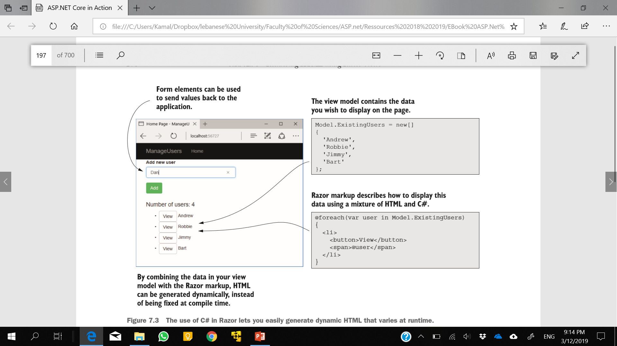
Example

Slide 5
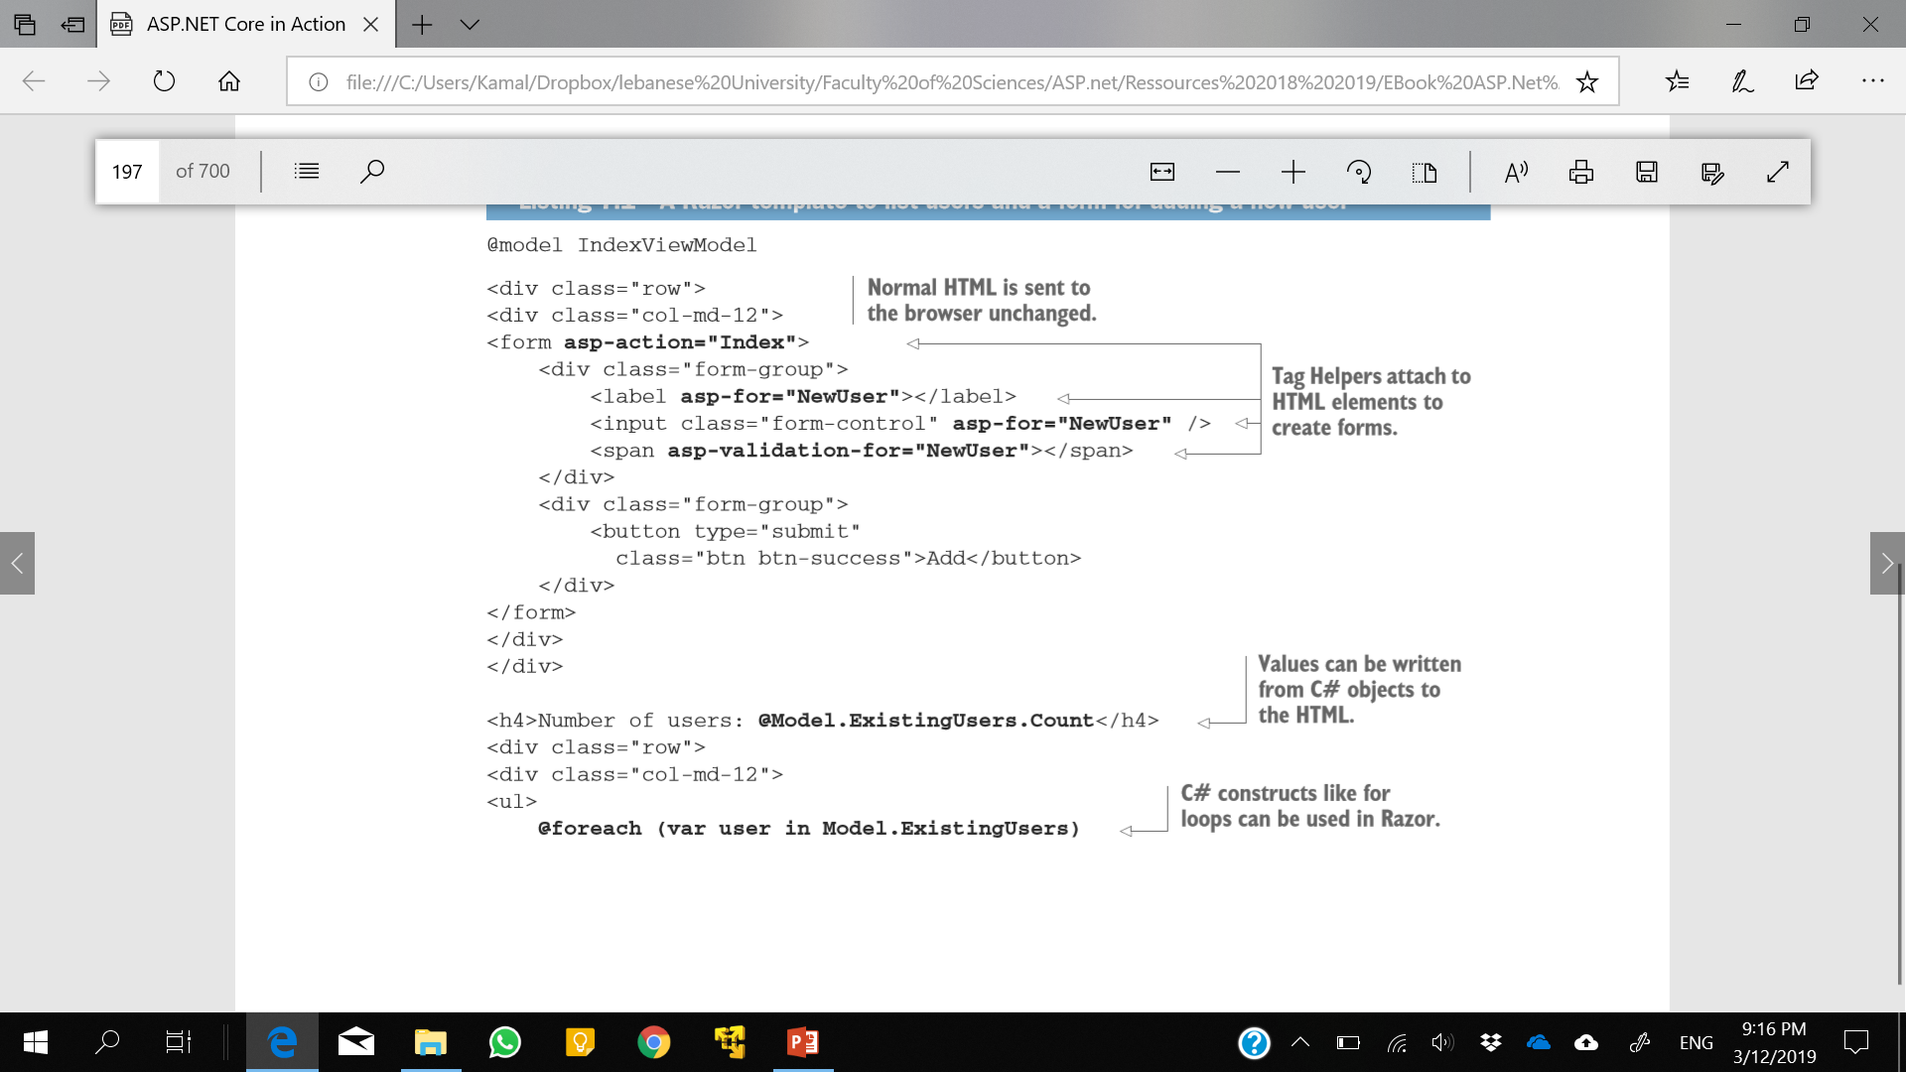
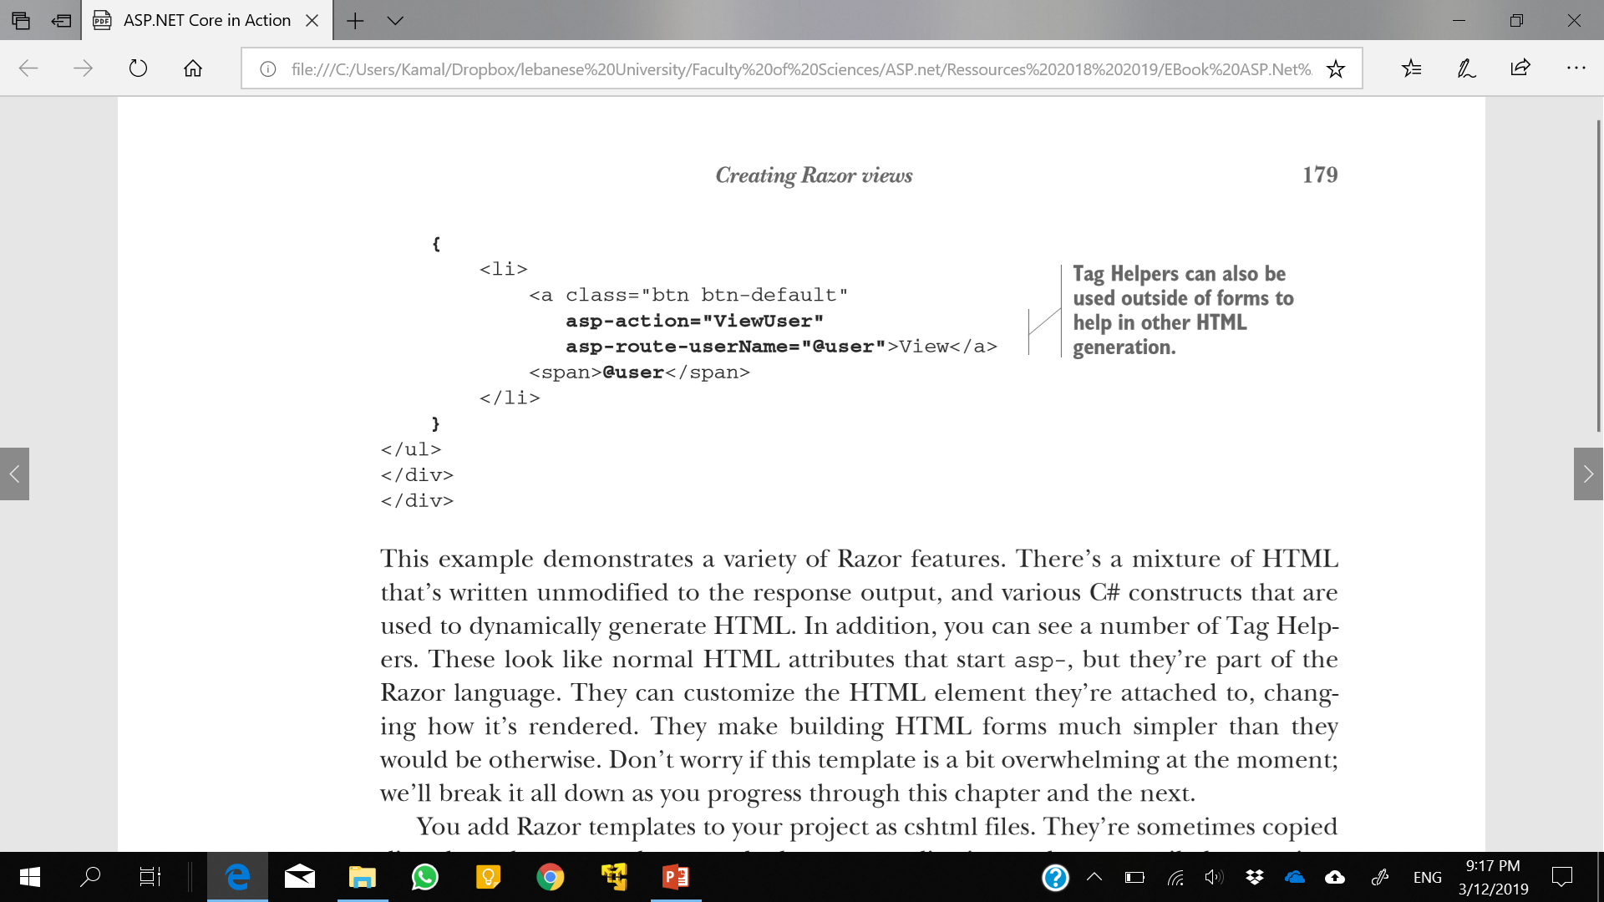
You add Razor templates to your project as cshtml files.
Notes:
In addition, you can see a number of Tag Helpers. These look like normal HTML attributes that start asp-, but they’re part of the Razor language.
You add Razor templates to your project as cshtml files. They’re sometimes copied directly to the server when you deploy your application and are compiled at runtime by your application.
Like most things in ASP.NET Core, it’s possible to swap out the Razor templating engine and replace it with your own server-side rendering engine. You can’t replace Razor with a client-side framework like AngularJS or React. If you want to take this approach, you’d use Web APIs instead.

Slide 6
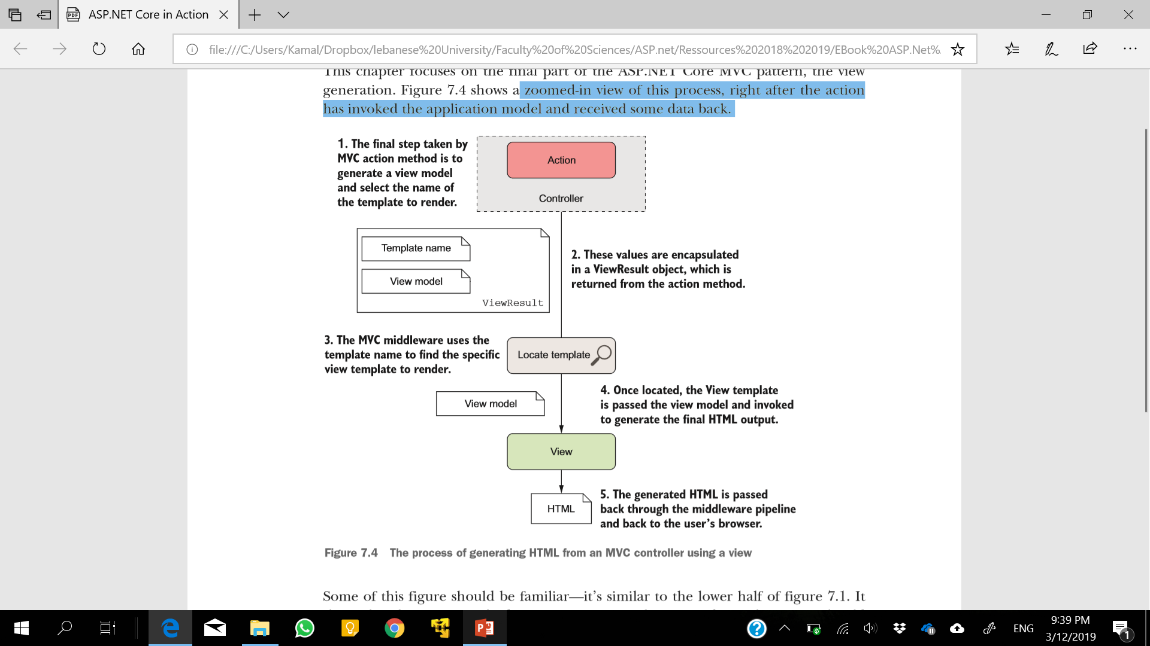
Creating Razor views
Notes:
With ASP.NET Core, whenever you need to display an HTML response to the user, you should use a view to generate it.

Slide 7
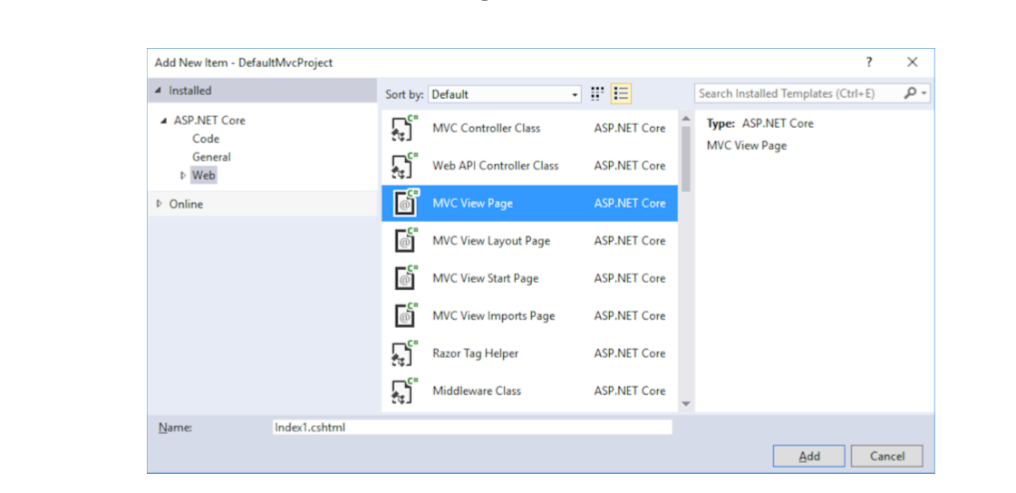
Add MVC View page
Right-click in your application in Solution Explorer and choosing Add > New Item, and selecting MVC View Page from the dialog
Notes:
You can add a new view template to your application in Visual Studio by right-clicking in your application in Solution Explorer and choosing Add > New Item, and selecting MVC View Page from the dialog, as shown in the figure. If you aren’t using Visual Studio, create a blank new file with the cshtml file extension.

Slide 8
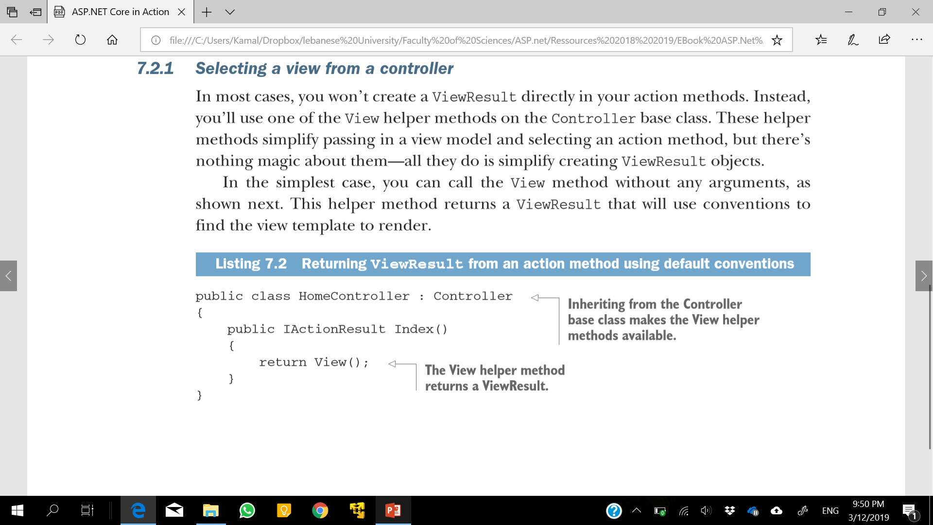
Selecting a view from a controller
The name of the template to use is based on the name of the action method.
Given that the controller is called HomeController and the method is called Index, by default the Razor template engine will look for a template at the Views/Home/Index.cshtml location.
Notes:
In most cases, you won’t create a ViewResult directly in your action methods. Instead, you’ll use one of the View helper methods on the Controller base class. These helper methods simplify passing in a view model and selecting an action method, but there’s nothing magic about them—all they do is simplify creating ViewResult objects.
As always, the conventions are optional. You can also explicitly pass the name of the template to run as a string to the View method. For example, if the Index method instead returned View("ListView");, then the templating engine would look for a template called ListView.cshtml instead. You can even specify the complete path to the view file, relative to your application’s root folder, such as View ("Views/global.cshtml");,which would look for the template at the Views/global .chtml location.

Slide 9
Define Explicit View
You can also explicitly pass the name of the template to run as a string to the View method.
For example, if the Index method instead returned View("ListView");
then the templating engine would look for a template called ListView.cshtml instead.
You can even specify the complete path to the view file, relative to your application’s root folder, such as View ("Views/global.cshtml");

Slide 10
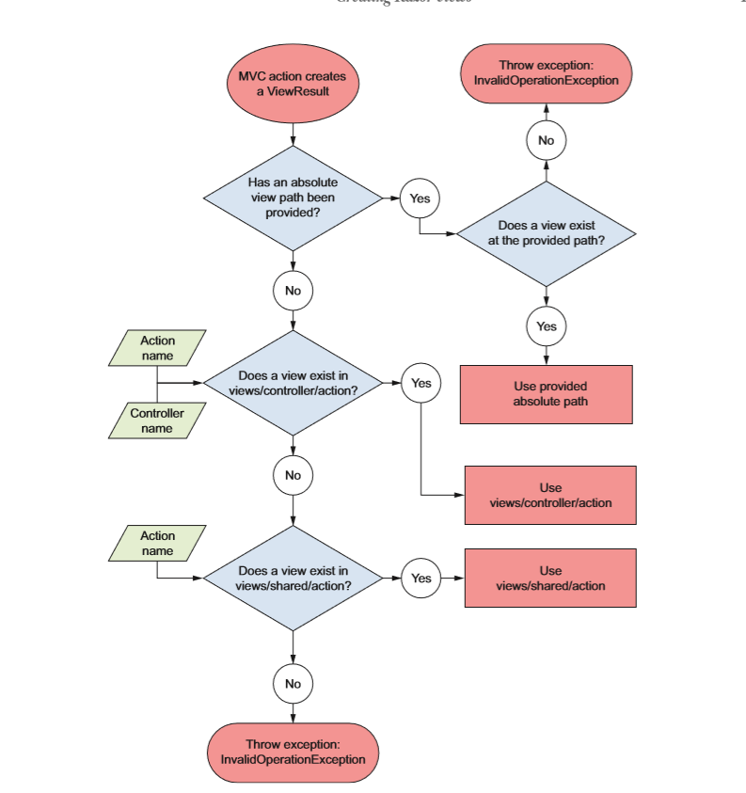
Notes:
complete process used by the default Razor templating engine to try to locate the correct View template to execute

Slide 11
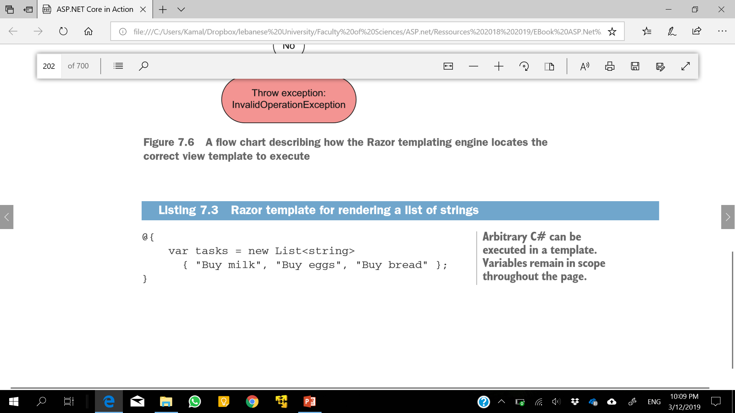
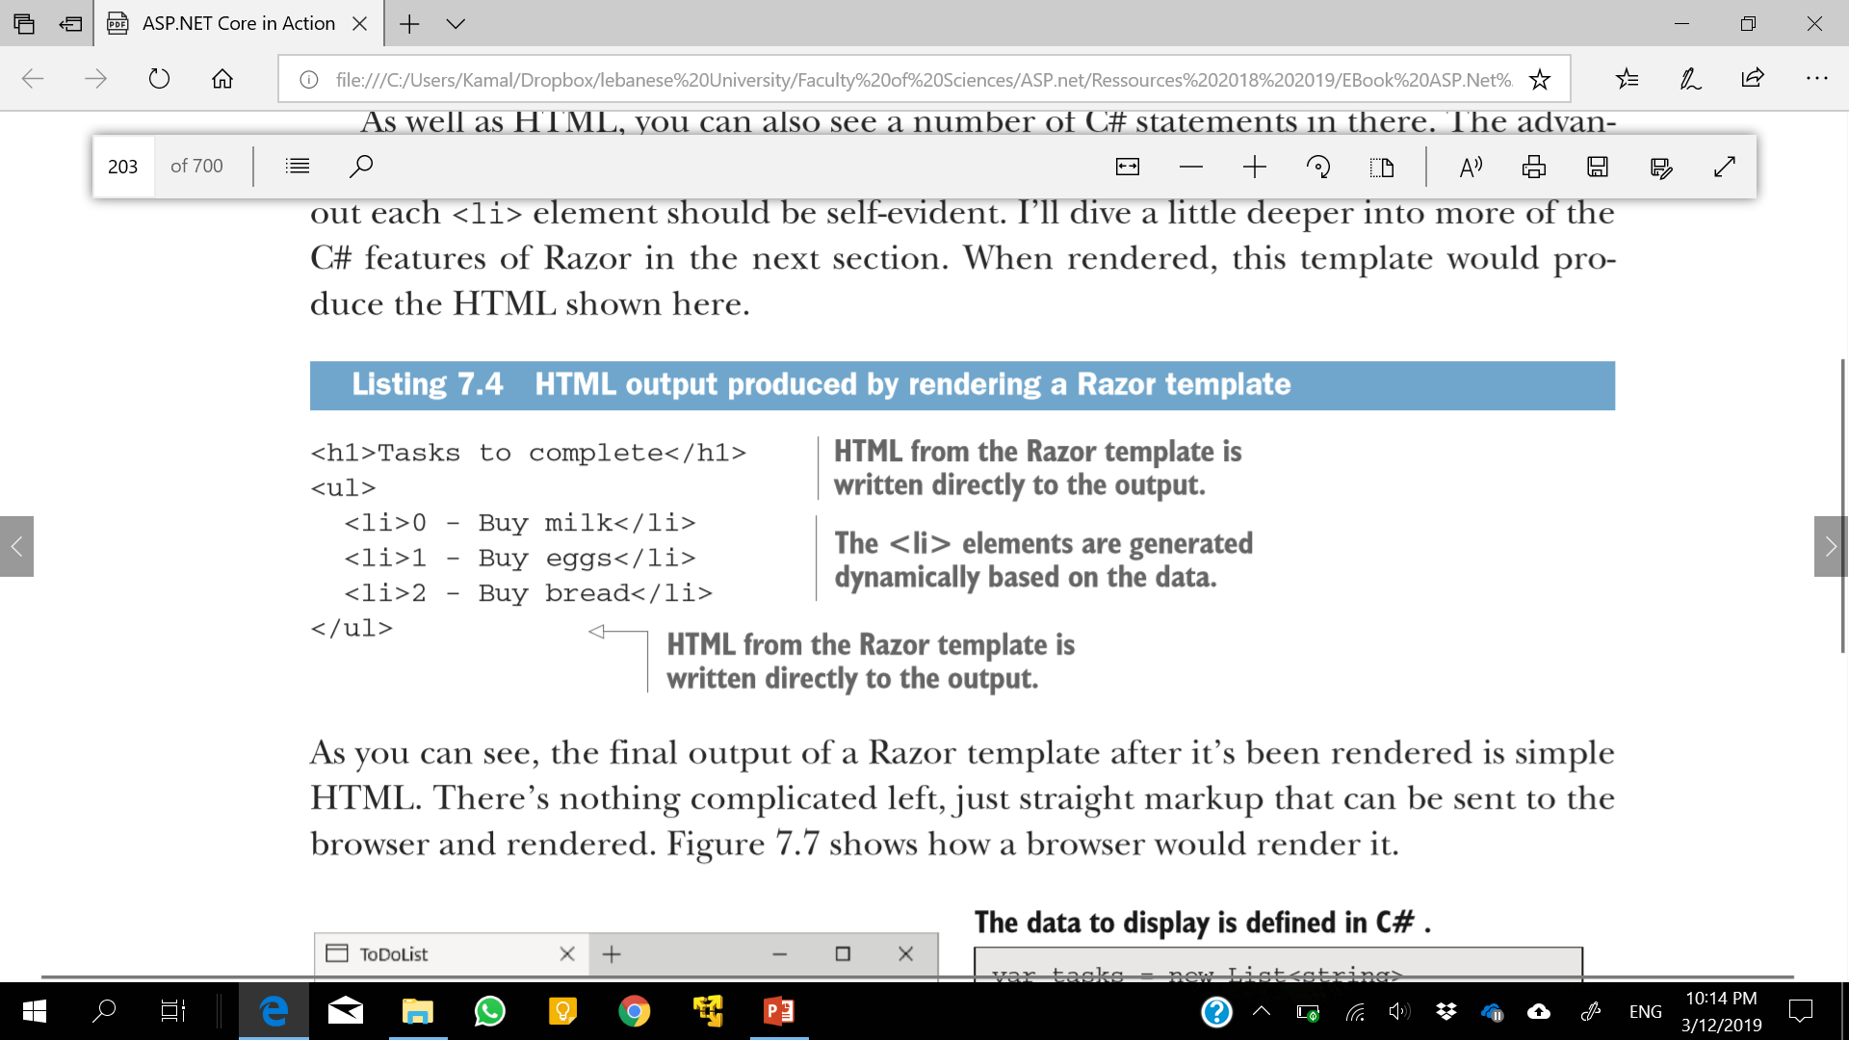
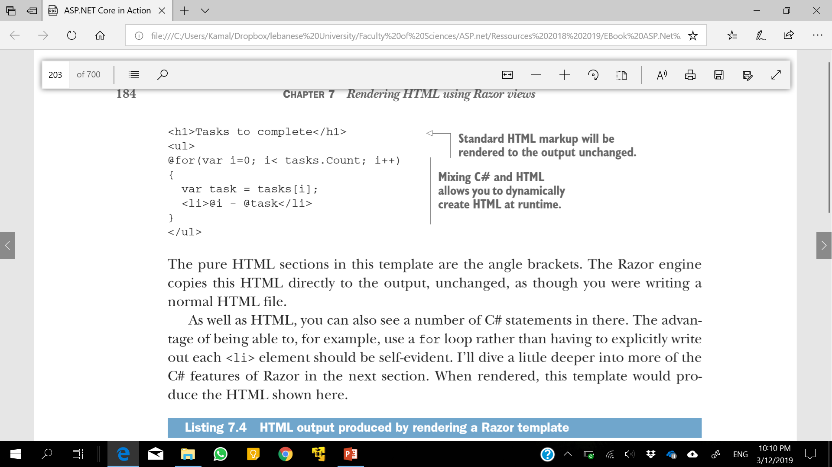
Example

Slide 12
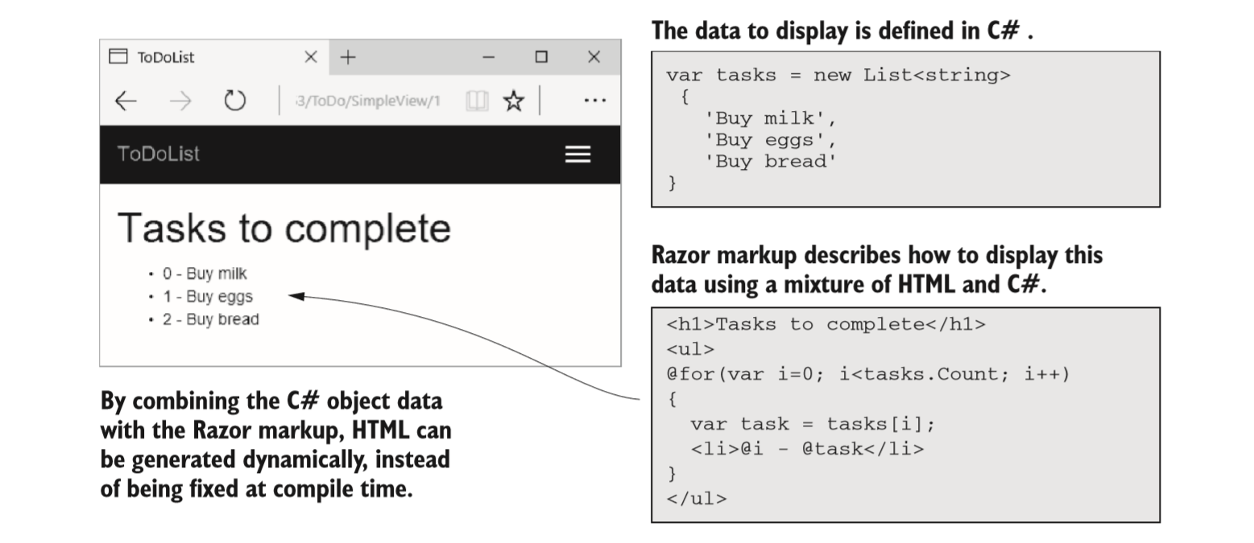
Output

Slide 13
Passing data to views
View model — used to encapsulate any data that needs to be displayed, which is specific to that view.
strongly typed class that can be any sort of object you like.
available in the view when it’s rendered, as you’ll see shortly.
ViewData —This is a dictionary of objects with string keys that can be used to pass arbitrary data from the controller to the view.
Notes:
Many ways of passing data from an action method in a controller to a view.

Slide 14
Passing data to views
ViewBag —A version of the ViewData that uses C# dynamic objects instead of string keys. It’s a wrapper around the ViewData object, so you can use it in place of ViewData if you prefer dynamic to Dictionary.
HttpContext — Available in both the controller and view, so you could use it to transfer data between them.
But don’t—there’s no need for it with the other methods and abstractions available to you.
The best approach is to use a view model. There’s nothing special about a view model;
Notes:
Many frameworks have the concept of a data context for binding UI components. The view model is a similar concept, in that it contains values to display in the UI, but the binding is only one-directional; the view model provides values to the UI, and once the UI is built and sent as a response, the view model is destroyed.

Slide 15
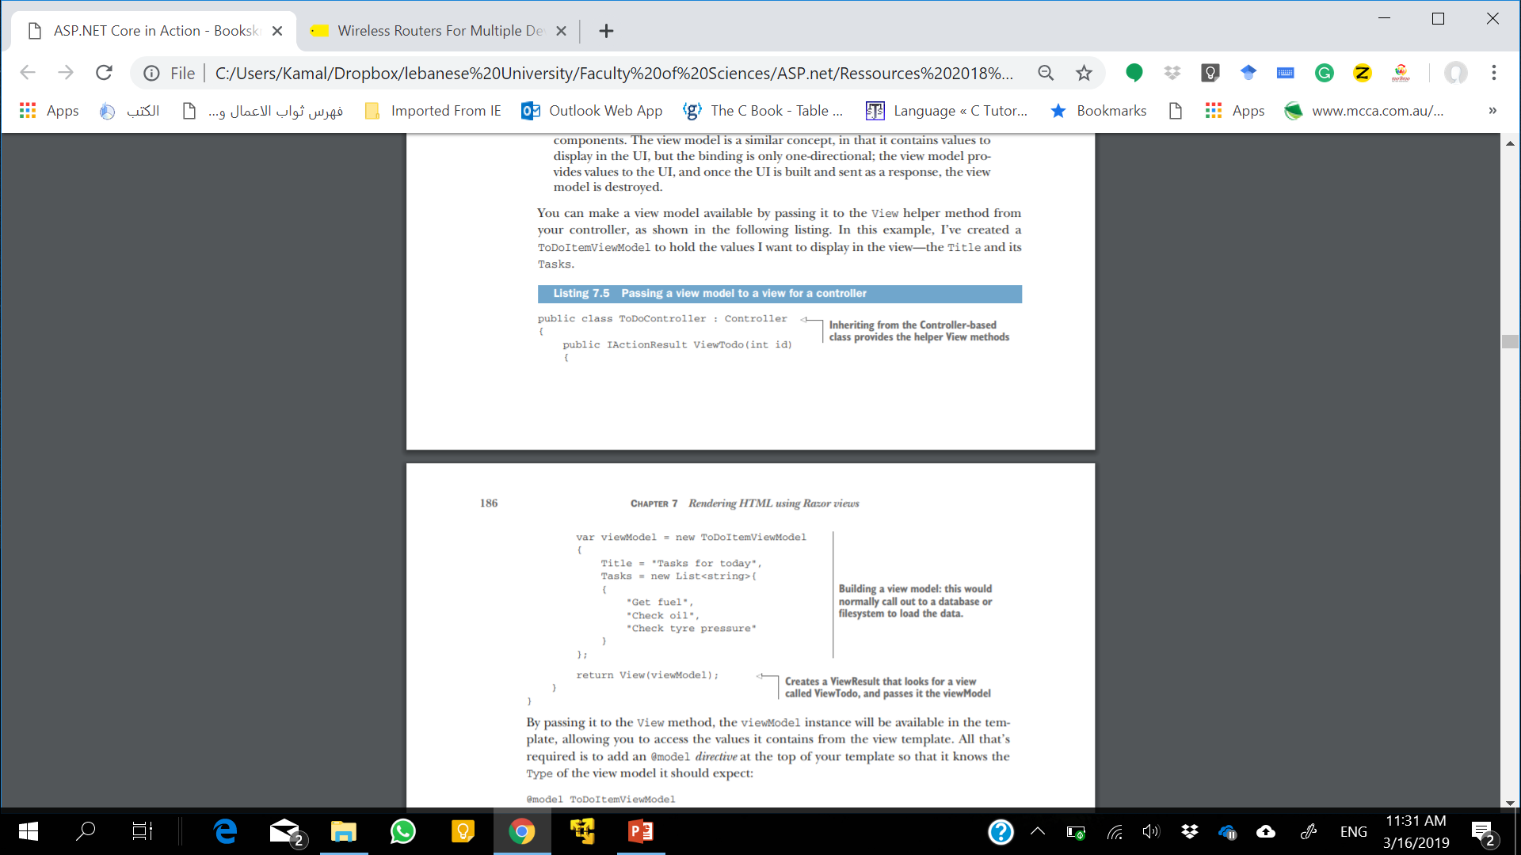
Passing a view model to a view for a controller
By passing it to the View method, the viewModel instance will be available in the template, allowing you to access the values it contains from the view template.
All that’s required is to add an @model directive at the top of your template so that it knows the type of the view model it should expect
@model ToDoItemViewModel
Notes:
A directive is a statement in a Razor file that changes the way the template is parsed or compiled. Another common directive is the @using newNamespace directive, which would make objects in the newNamespace namespace available.

Slide 16
Model property
You can access any of the data.
to display the Title property from the ToDoItemViewModel, you’d use <h1>@Model.Title</h1>.
➔ <h1>Tasks for today<h1>.
The @model directive should be at the top of your view, and has a lowercase m.
The Model property can be accessed anywhere in the view and has an uppercase M.

Slide 17
ViewData Collection
public IActionResult Contact() {
ViewData["Message"] = "Your contact page.";
return View();
}
They’re then displayed in the template using
@ViewData["Message"]
Notes:
In the vast majority of cases, using a view model is the way to go; it’s the standard mechanism for passing data between the controller and the view. But in some circumstances, a view model may not be the best fit. This is often the case when you want to pass data
between view layouts (you’ll see how this works in the last section of this chapter).
A common example is the title of the page. You need to provide a title for every page, so you could create a base class with a Title property and make all your view models inherit from it. But that’s a little cumbersome, so a common approach for this situation is to use the ViewData collection to pass data around.

Slide 18
ViewData Collection
You can also set values on the ViewData dictionary from within the view itself:
@{
ViewData["Title"] = "About";
}
<h2>@ViewData["Title"].</h2>
Notes:
Create a set of global, static constants for any ViewData keys, and reference those instead of typing "Title" repeatedly. You’ll get IntelliSense for the values, they’ll be refactor-safe, and you’ll avoid hard-to-spot typos.

Slide 19
Creating dynamic web pages with Razor
The cshtml files are compiled into normal C# code (with string for the raw HTML sections)
Whatever weird and wonderful behavior you need can be created.
Notes:
This section covers some of the more common C# constructs you can use. If you find you need to achieve something a more exotic, refer to the Razor syntax documentation at https://docs.microsoft.com/en-us/aspnet/core/mvc/views/razor.

Slide 20
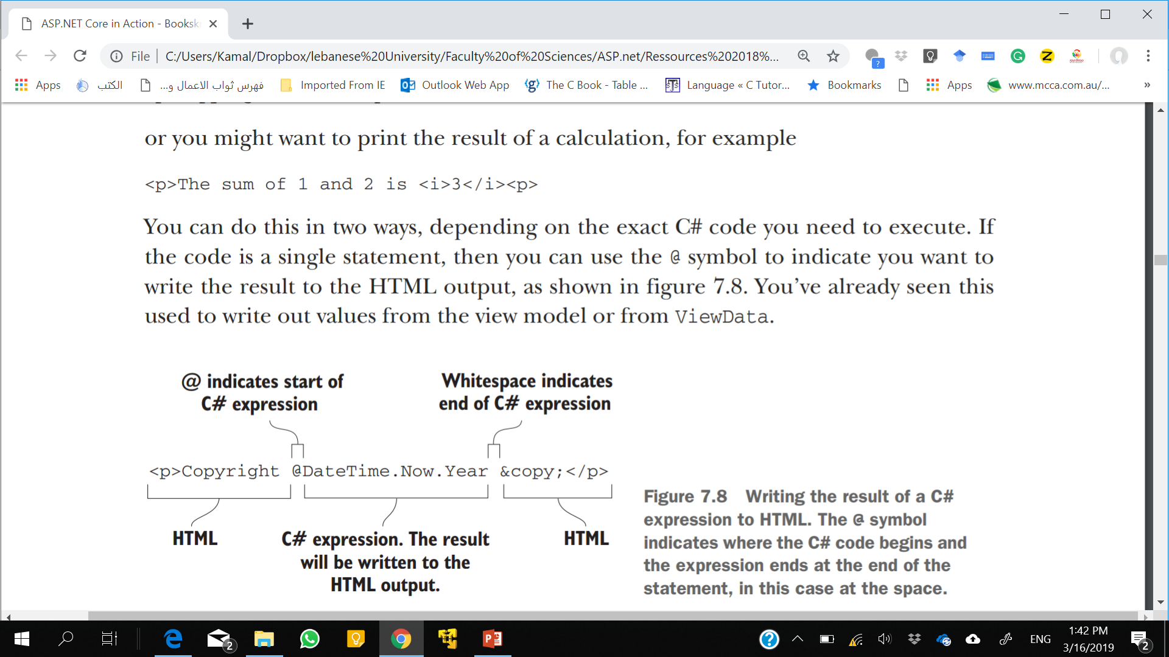
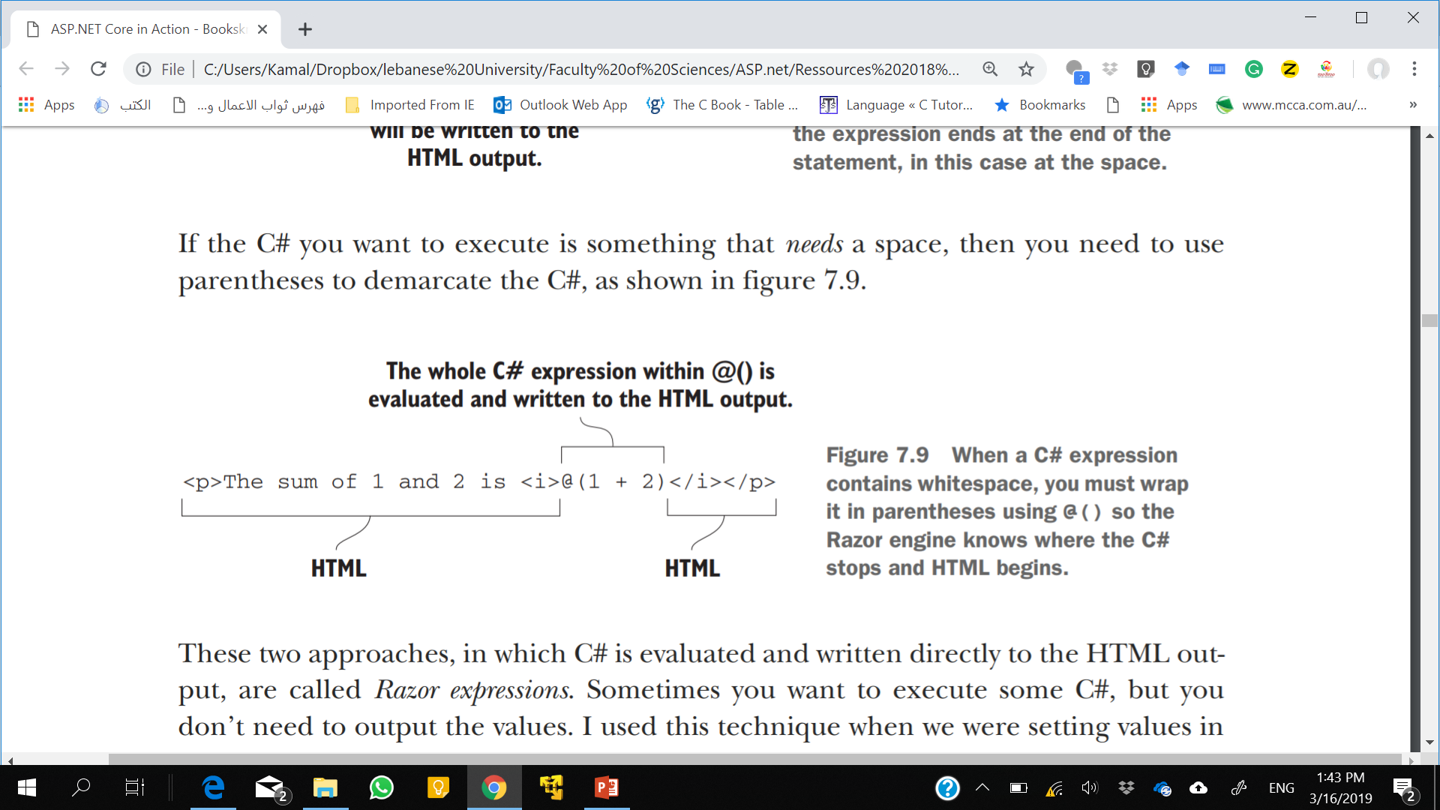
Using C# in Razor templates
Razor expressions

Slide 21
Using C# in Razor templates
Razor code block : identified by the @{} structure
@{
ViewData["Title"] = "About";
}
Notes:
When you execute code within code blocks, it must be valid C#, so you need to add semicolons. Conversely, when you’re writing values directly to the response using Razor expressions, you don’t need them. If your output HTML breaks unexpectedly, keep an eye out for missing or rogue extra semicolons!

Slide 22
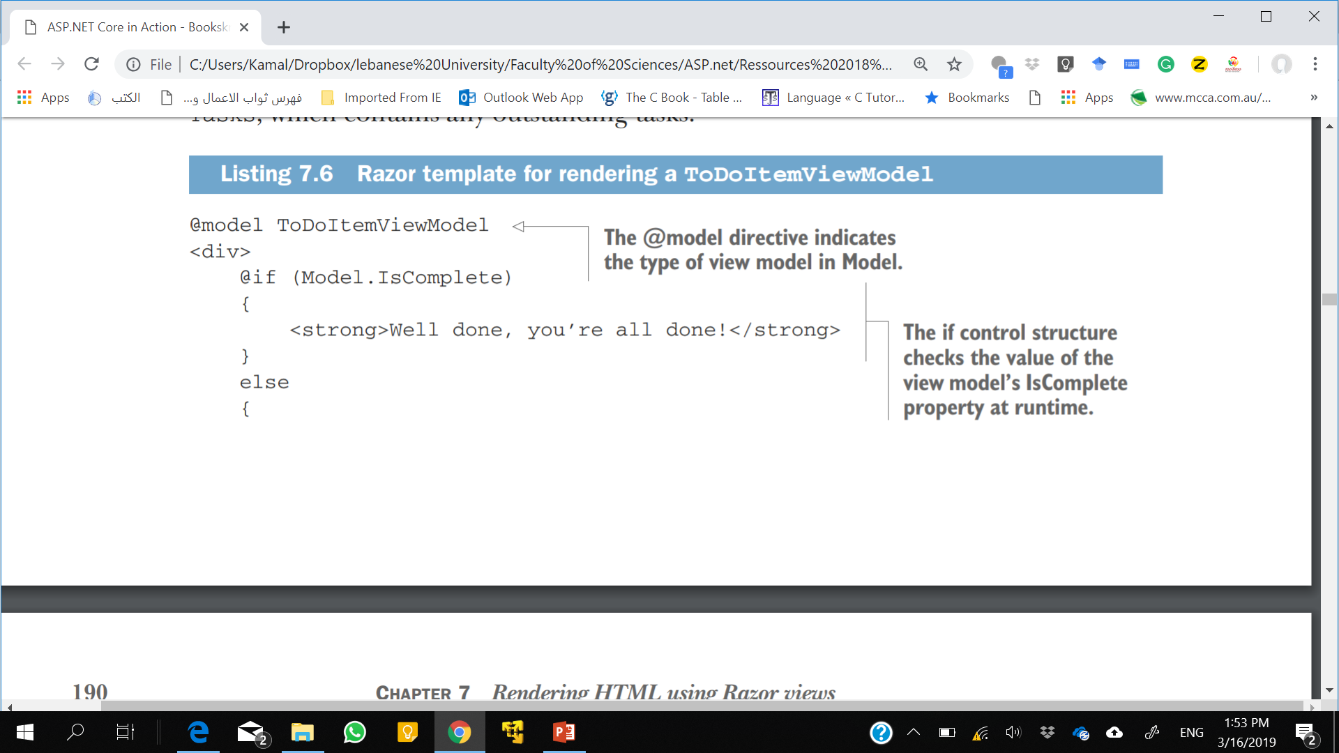
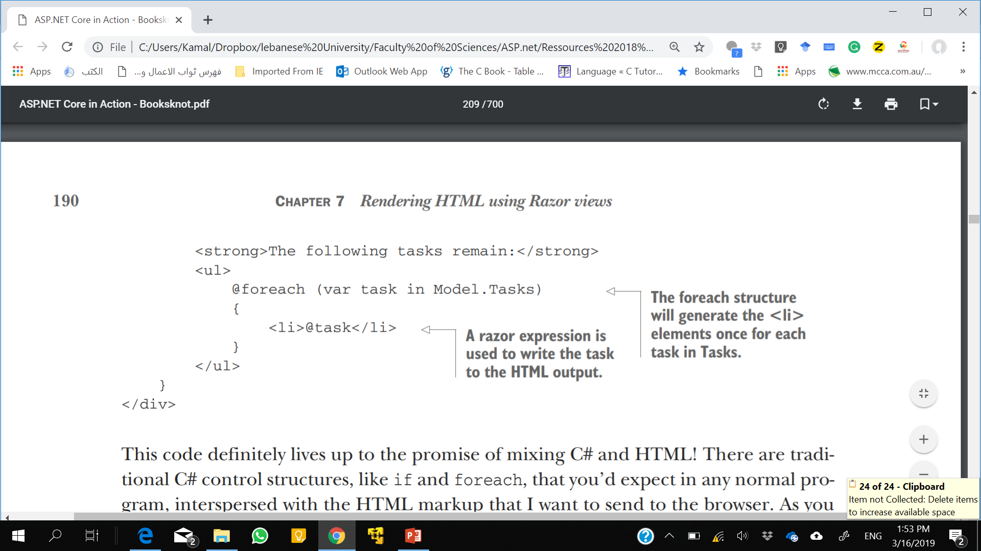
Adding loops and conditionals to Razor templates
One of the biggest advantages of using Razor templates over static HTML is the ability to dynamically generate the output.

Slide 23
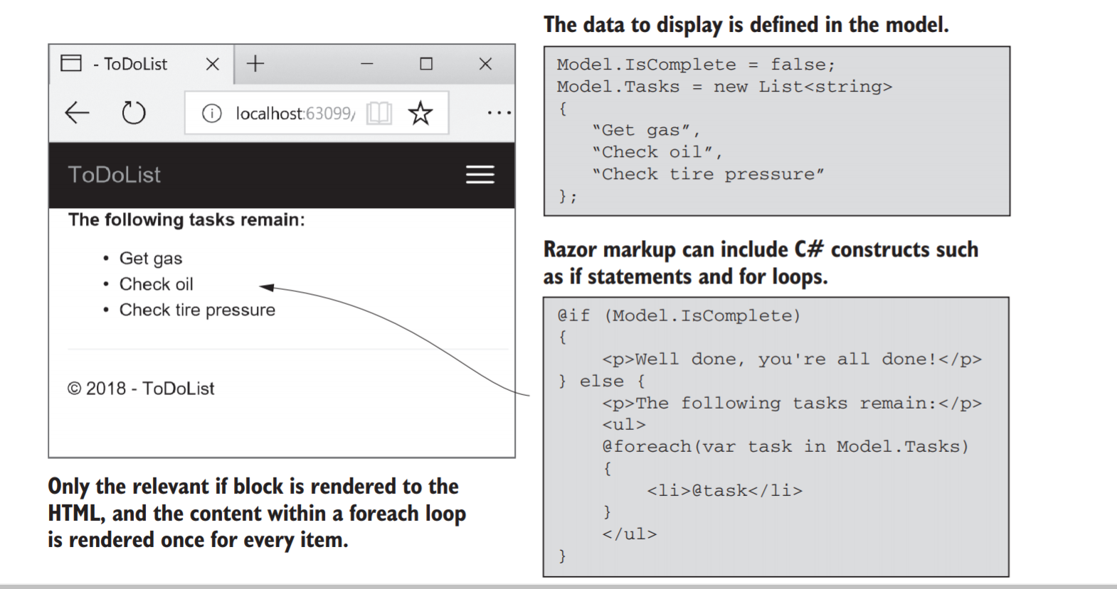
Output

Slide 24
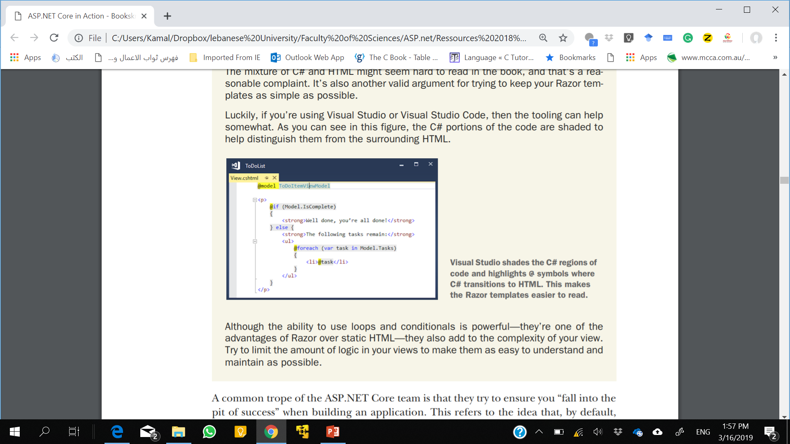

Slide 25
Rendering HTML with Raw
What if the task variable contains HTML you want to display?
It contains "<strong>Check oil</strong>"? then you might hope to get this:
<li><strong>Check oil</strong></li>
But that’s not the case. The HTML generated comes out like this:
<li>&lt;strong&gt;Check oil&lt;/strong&gt;</li>

Slide 26
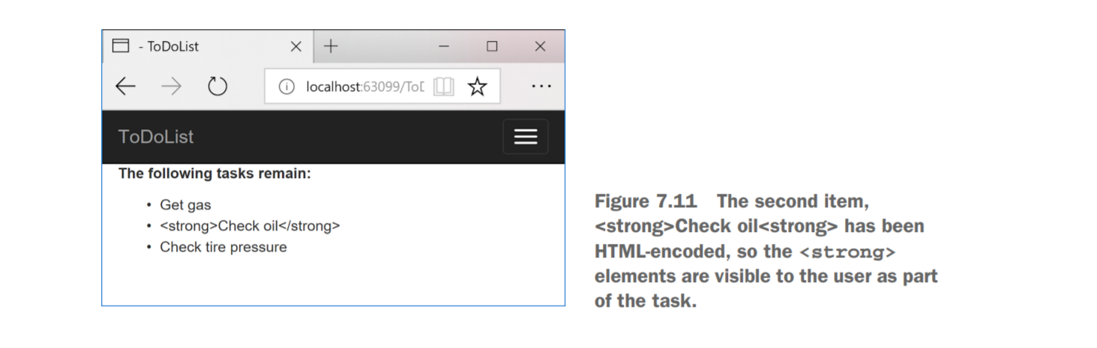
Output
Razor templates encode C# expressions before they’re written to the output stream.
If you really need to write the variable out to the HTML stream, then you can do so using the Html property on the view page and calling the Raw method:
<li>@Html.Raw(task)</li>
Notes:
This is primarily for security reasons; writing out arbitrary strings to your HTML could allow users to inject malicious data and JavaScript into your website. Consequently, the C# variables you print in your Razor template get written as HTML-encoded values.
Using Html.Raw on user input creates a security risk that users could use to inject malicious code into your website. Avoid using Html.Raw if possible!
You can still use this approach in ASP.NET Core by using the various HtmlHelper1 methods on the Html property, but these have largely been superseded by a cleaner technique: Tag Helpers.

Slide 27
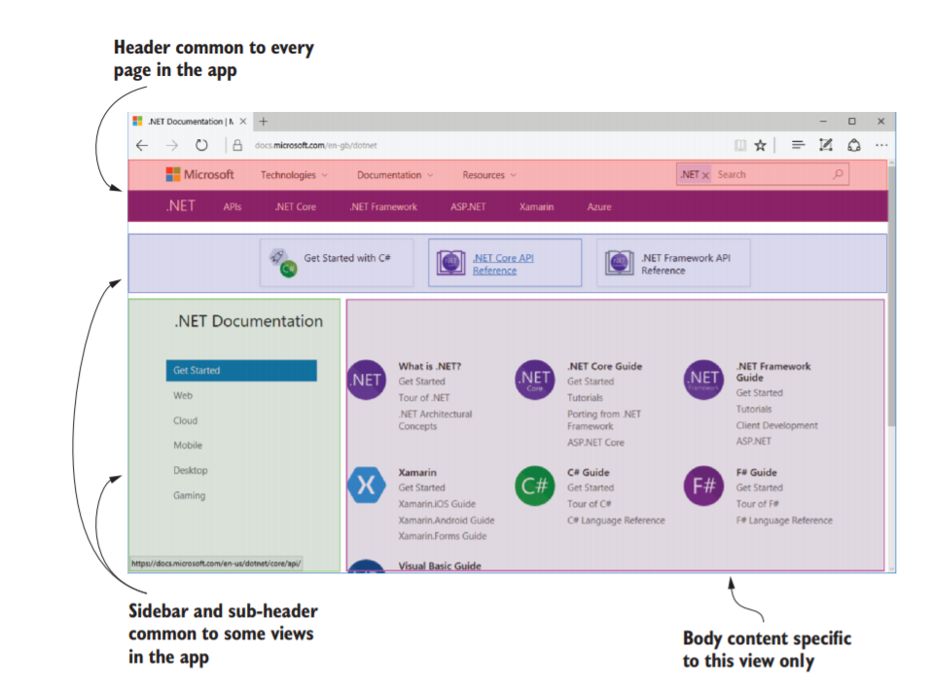
Layouts, partial views, and _ViewStart
Each page on your application will also probably reference the same CSS and JavaScript files.
A layout in Razor is a template that includes common code.
It can’t be rendered directly, but it can be rendered in conjunction with normal Razor views.
Notes:
Every HTML document has a certain number of elements that are required: <html>, <head>, and <body>. As well, there are often common sections that are repeated on every page of your application, such as the header and footer, as shown in figure 7.13.

Slide 28
Using layouts for shared markup
Layout files are normal Razor templates that contain markup common to more than one page.
An ASP.NET Core app can have multiple layouts, and layouts can reference other layouts.
You’ll often use layouts across many different action methods, so they’re typically placed in the Views/Shared folder.
You can name them anything you like, but there’s a common convention to use _Layout.cshtml as the filename for the base layout in your application. This is the default name used by the MVC templates in Visual Studio and the .NET CLI.
Notes:
A common use for this is to have different layouts for different sections of your application.

Slide 29
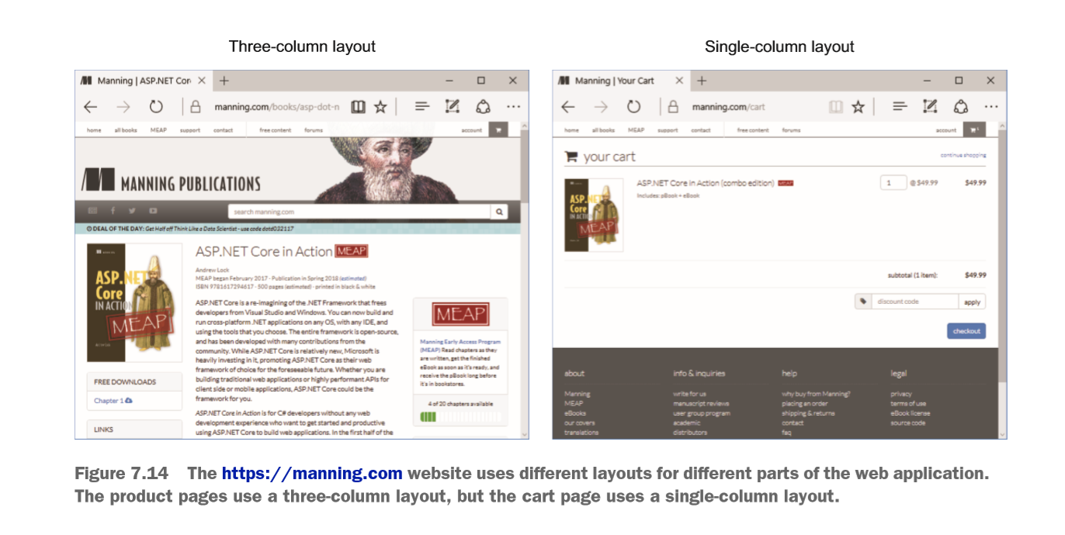

Slide 30
Razor Layout
A layout file looks similar to a normal Razor template, with one exception: every layout must call the @RenderBody( ) function.
This tells the templating engine where to insert the content from the child views.
Typically, your application will reference all your CSS and JavaScript files in the layout, as well as include all the common elements such as headers and footers.
Notes:
By extracting your common markup into layouts, you can reduce the duplication in your app. This makes changes easier, makes your views easier to manage and maintain, and is generally good practice!

Slide 31
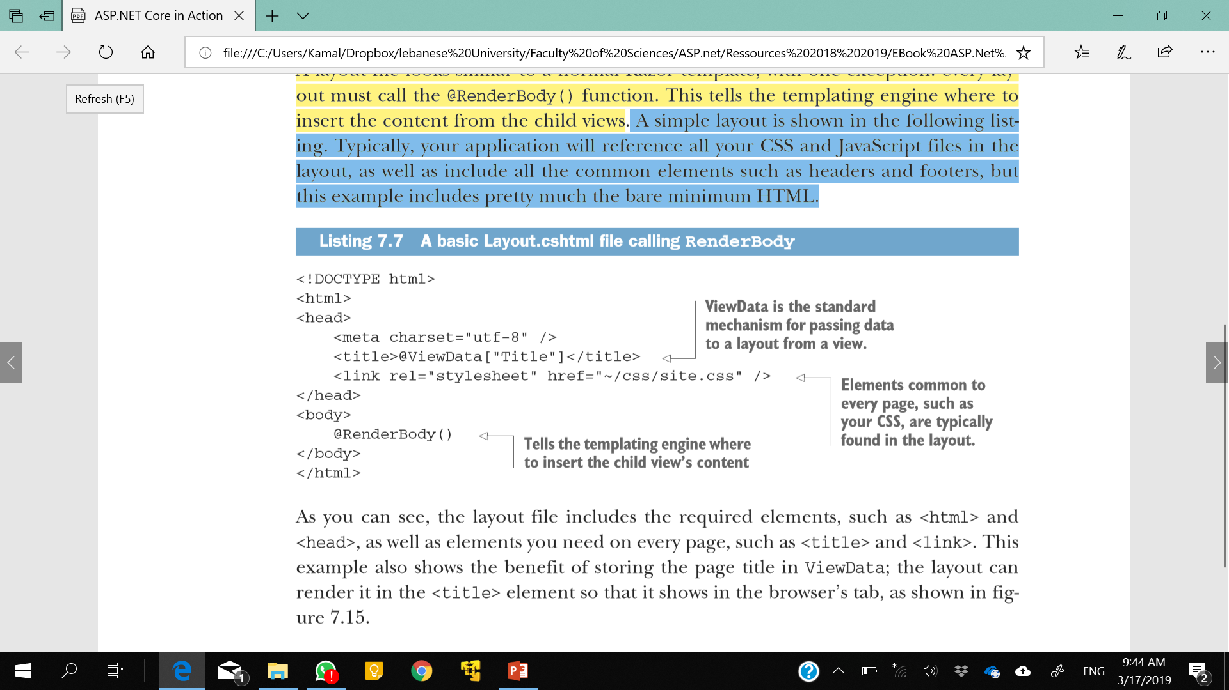
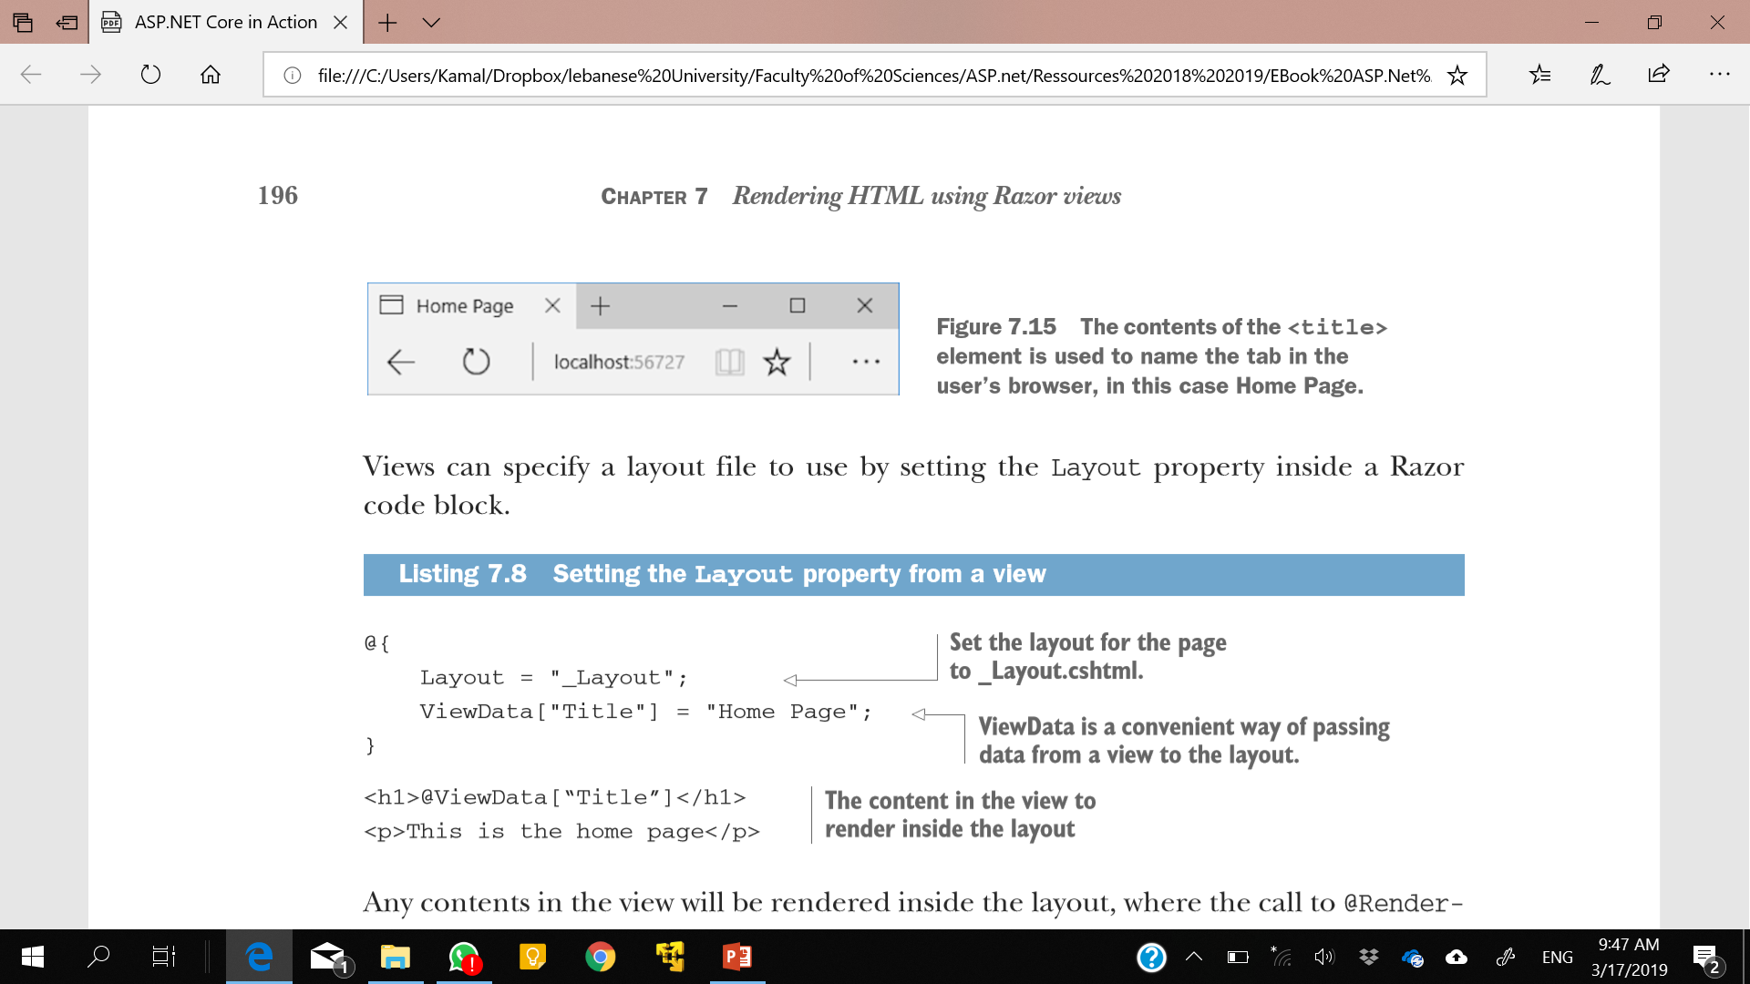
Example

Slide 32
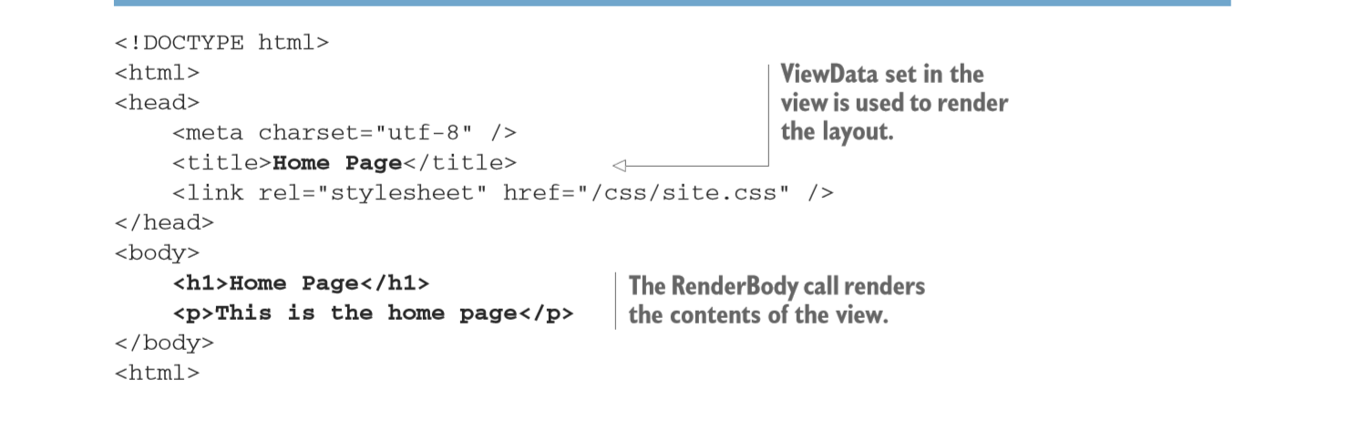
Example
By default, layouts only provide a single location where you can render content from the view, at the call to @RenderBody.
In cases where this is too restrictive, you can render content using sections.

Slide 33
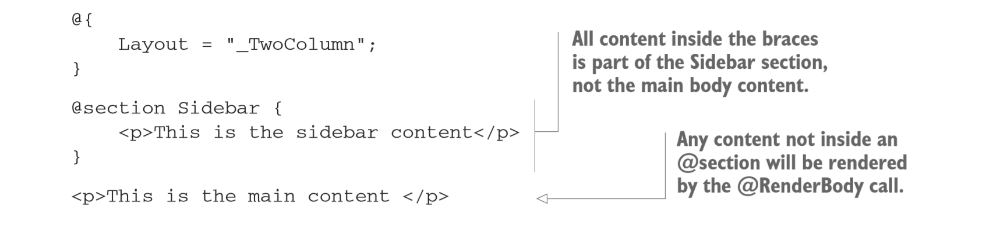
Overriding parent layouts using sections
Be able to render content from child views in more than one place in your layout.
defined in the view using an @section definition.
The @section can be placed anywhere in the file, top or bottom, wherever is convenient.
Notes:
Remember, all of the features outlined in this chapter are specific to Razor, which is a server-side rendering engine. If you’re using a client-side SPA framework to build your application, you’ll likely handle these requirements in other ways, either within the client code or by making multiple requests to a Web API endpoint.

Slide 34
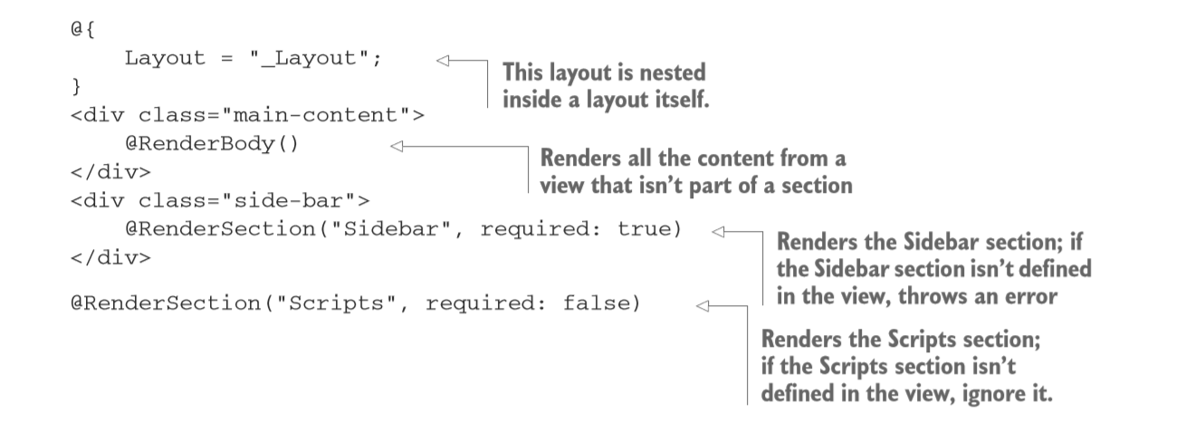
Overriding parent layouts using sections

Slide 35
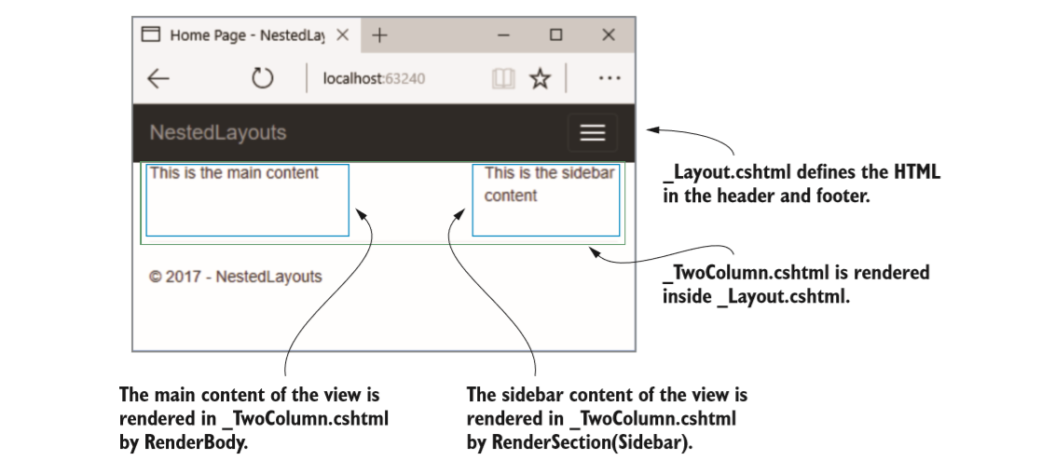
Output
Notes:
Layout files and sections provide a lot of flexibility to build sophisticated UIs, but one of their most important uses is in reducing the duplication of code in your application.

Slide 36
Using partial views to encapsulate markup
They provide a means of breaking up a larger view into smaller, reusable chunks.
This can be useful for both reducing the complexity in a large view by splitting it into multiple partial views, or for allowing you to reuse part of a view inside another.

Slide 37
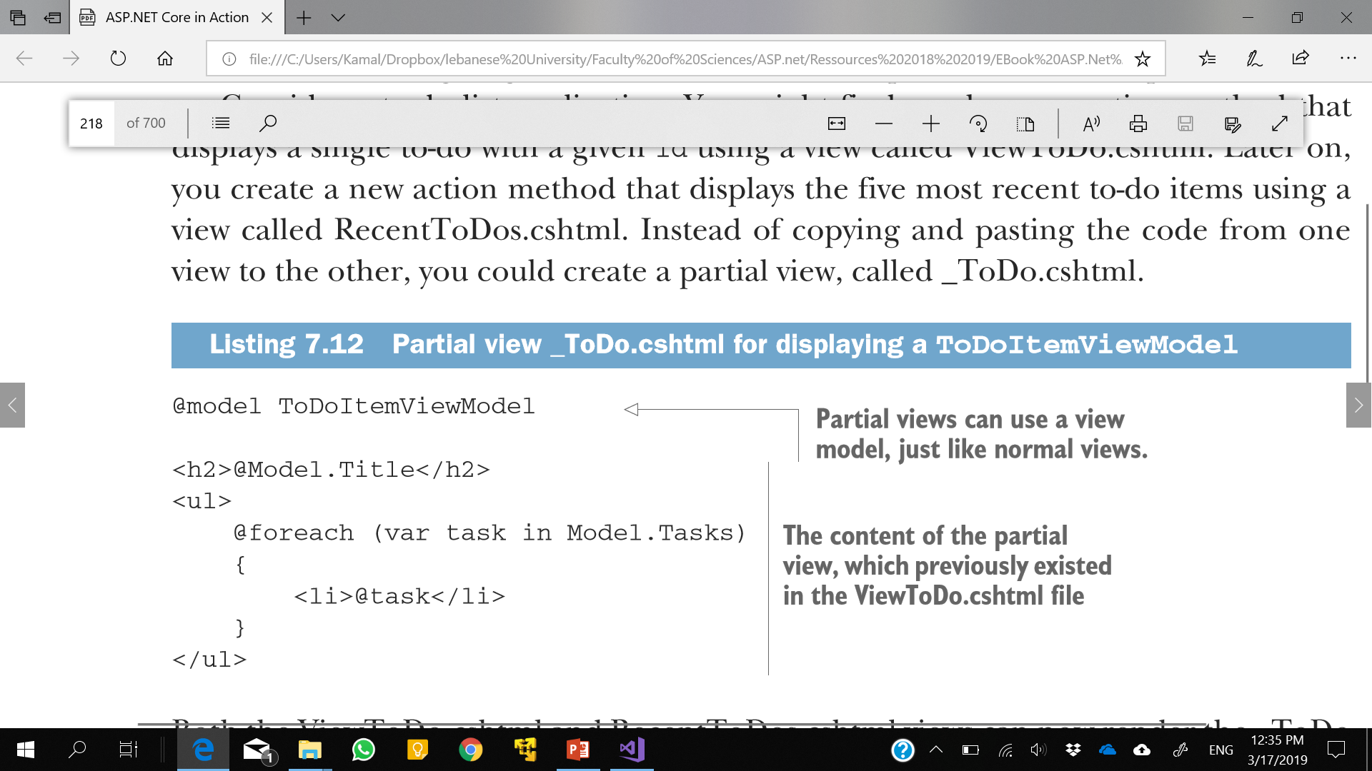
Example

Slide 38
Partial Views
Partial views are rendered using the @await Html.PartialAsync method and can be passed a view model to render.
@model List<ToDoItemViewModel>
@foreach(var todo in Model) {
@await Html.PartialAsync("_ToDo", todo)
}
You can call the partial in a number of other ways, such as Html.Partial and Html.RenderPartial, but Html.PartialAsync is recommended.
Notes:
Like layouts, partial views are typically named with a leading underscore. The Razor code contained in a partial view is almost identical to a standard view. The main difference is the fact that partial views are typically called from other views rather than as the result of an action method. The only other difference is that partial views don’t run _ViewStart.cshtml when they execute, which you’ll see shortly.

Slide 39
Running code on every view with _ViewStart and _ViewImports
If all of your views use the same layout, then adding the following code to the top of every page feels a little redundant
@{ Layout = "_Layout"; }
if you’ve declared your view models in a different namespace to your app’s default,
for example the WebApplication1.Models namespace, then having to add @using WebApplication1.Models
ASP.NET Core includes two mechanisms for handling these common tasks: _ViewImports.cshtml and _ViewStart.cshtml.

Slide 40
Running Code For Every View With _ViewStart
You can easily run common code at the start of every view by adding a _ViewStart file to the Views folder in your application.
This file can contain any Razor code, but it’s typically used to set the Layout for all the views in your application.
@{ Layout = "_Layout"; }
Any code in the _ViewStart.cshtml file runs before the view executes.
_ViewStart.cshtml only runs for full views—it doesn’t run for layouts or partials views.
Notes:
Also, note that the names for these special Razor files are enforced rather than conventions. If you only want to run _ViewStart.cshtml or _ViewImports.cshtml for some of your views, you can include additional _ViewStart.cshtml or _ViewImports.cshtml files in a controller-related subfolder. The controller-specific files will run after the root Views folder files.

Slide 41
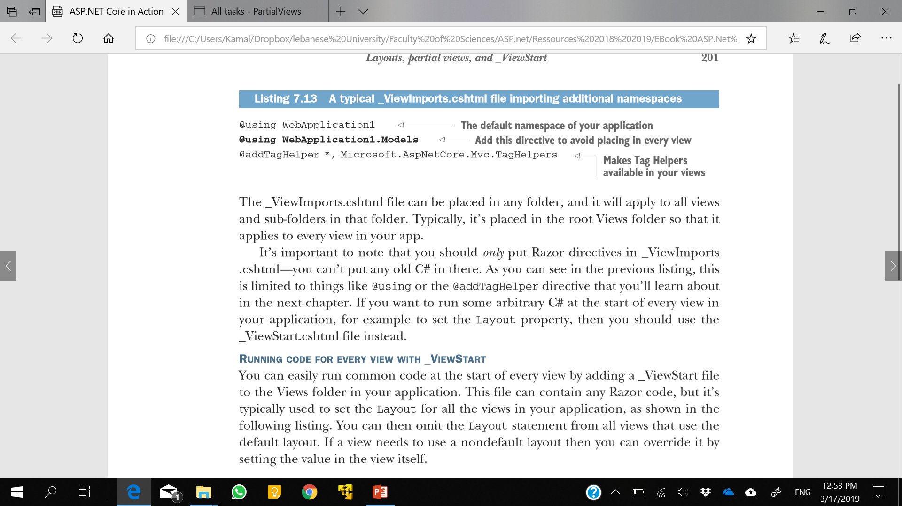
Importing Common Directives With _ViewImports
The _ViewImports.cshtml file contains directives that will be inserted at the top of every view.
This includes things like the @using and @model statements or any Razor directive.
The _ViewImports.cshtml file can be placed in any folder, and it will apply to all views and sub-folders in that folder. Typically, it’s placed in the root Views folder.

Slide 42
Summary
In MVC, views are responsible for generating the UI for your application.
Razor is a templating language that allows you to generate dynamic HTML using a mixture of HTML and C#.
HTML forms are the standard approach for sending data from the browser to the server. You can use Tag Helpers to easily generate these forms.
By convention, views are named the same as the action that invokes them, and reside either in a folder with the same name as the action method’s controller or in the Shared folder.
Controllers can override the default view template by passing the template name when returning a ViewResult using the View helper method on the Controller base class.

Slide 43
Summary
Controllers can pass strongly typed data to a view using a view model. To access the properties on the view model, the view should declare the model type using the @model directive.
Controllers can pass key-value pairs to the view using the ViewData dictionary.
Razor expressions render C# values to the HTML output using @ or @(). You don’t need to include a semicolon after the statement when using Razor expressions.
Razor code blocks, defined using @{}, execute C# without outputting HTML. The C# in Razor code blocks must be complete statements, so it must include semicolons.
Loops and conditionals can be used to easily generate dynamic HTML in templates, but it’s a good idea to limit the number of if statements in particular, to keep your views easy to read.

Slide 44
Summary
If you need to render a string as raw HTML you can use Html.Raw, but do so sparingly—rendering raw user input can create a security vulnerability in your application.
Tag Helpers allow you to bind your data model to HTML elements, making it easier to generate dynamic HTML while staying editor friendly.
You can place HTML common to multiple views in a layout. The layout will render any content from the child view at the location @RenderBody is called.
Encapsulate commonly used snippets of Razor code in a partial view. A partial view can be rendered using @await Html.PartialAsync().

Slide 45
Summary
_ViewImports.cshtml can be used to include common directives, such as @using statements, in every view.
_ViewStart.cshtml is called before the execution of each main view and can be used to execute code common to all views, such as a default layout page. It doesn’t execute for layouts or partial views.
_ViewImports.cshtml and _ViewStart.cshtml are hierarchical—files in the root folder execute first, followed by files in controller-specific view folders.

